Slide 1
(Agentic) RAG Chatbot
21/08/25

Slide 2
Introduction
What is RAG?
  Search (Retrieval): Dense vector search over chunked sections along with keyword search using BM25 (+ optional doc-scope narrowing by last_target).
  AI Answering (Generation): LLM composes answers strictly from retrieved evidence; cites exact section, printed page, and logical page.
  Agentic Control: Each step can be toggled; failures fall back safely (e.g., broaden retrieval if seed not found).
We have a production-style RAG that:
  Parses PDF/DOCX with TOC-aware logic, captures section_path, page_label (Roman/Arabic), and modality (text/table/figure).
  Uses an agent graph (retrieve → rerank → judge → clause locator → synthesize → cite) with debug traces.
  Maintains conversation memory (last document scope + used_sources) so follow-ups stay anchored to the same file unless the user switches context.

Slide 3
Why it’s useful for querying
Trustworthy: Every claim ties back to verifiable citations (doc name, section path, page printed/index).
Context-aware
Structured: Extracts requirements, external refs, subtopics, and next questions to guide deeper analysis.

Slide 4
High-level objective
Enable fast, accurate Q&A over multi-document project corpora (e.g., Agentic RAG WBS + related specs).
Preserve document structure to improve retrieval quality and explainability.
Provide actionable outputs (answers + sources + requirements + follow-ups) for PM/engineering workflows.

Slide 5
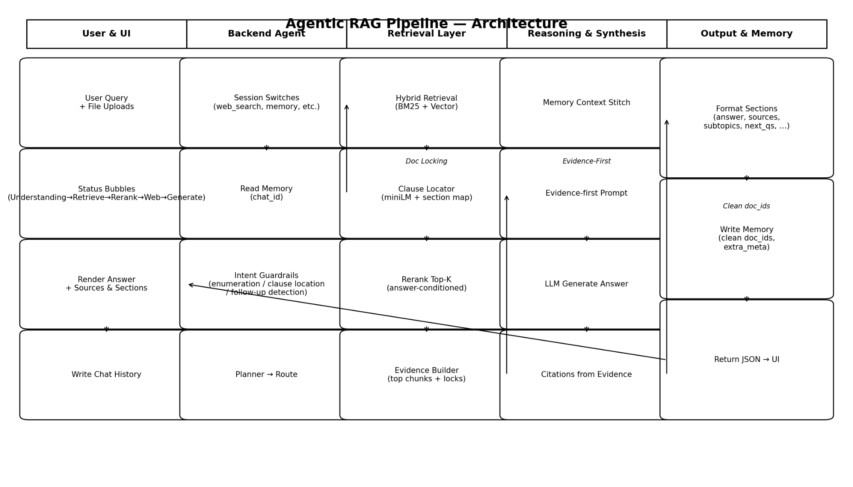
System Architecture

Slide 6
Key Features
TOC-aware parsing (handles multi-page TOCs, Roman→Arabic transitions).
Precise citations: “Doc: §section_path “title” (page printed N) (page M)”.
Scoped follow-ups via last_target and used_sources.
Toggles: reranker, web_search, follow_up, clause_locator, req_extractor, external_refs, citations, topic_suggestion, memory.
Diagnostics: per-step trace with pool sizes/sim scores.

Slide 7
Technical Implementation
Parsing: PyMuPDF, python-docx; heading/TOC normalization; page-label inference.
Chunking: token-bounded (e.g., 512 tokens, 50 overlap) with section-aware boundaries; modality captured for tables/figures.
Embeddings/Index: HuggingFace embeddings → chromadb; metadata filters for doc-scope retrieval.
Reranking: cosine-sim reranker before synthesis.
LLM: GPT-4o-mini (configurable to use local – Mistral 7B).
Memory I/O: app writes raw doc IDs (canonical source) to doc_ids; pretty source strings kept only for UI.

Slide 8
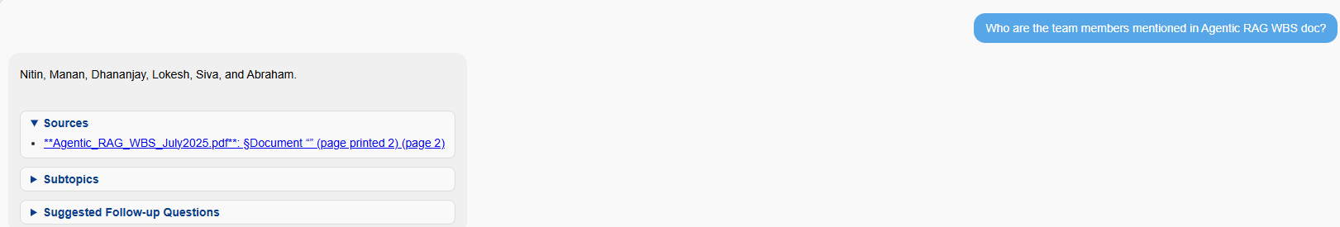
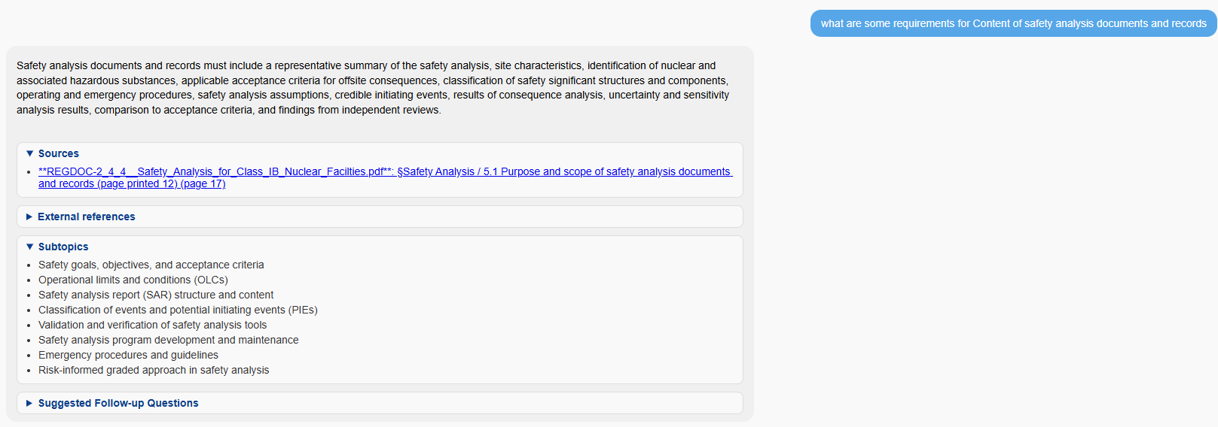
Demo

Slide 9
Challenges & Fixes
Scope loss on follow-ups: Don’t reset last_target on neutral queries; ensure used_sources returns canonical source.
Doc-ID mismatch: Store raw IDs (not pretty strings) in memory; unify on metadata["source"].
TOC spanning pages: Parse all TOC pages and stitch entries reliably.
Page label off-by-one: Normalize printed vs logical page indices; prefer printed label in citations.
Heading vs numbered list: Avoid false positives by cross-checking with TOC and font/layout signals.

Slide 10
Next Steps
Analytics
  Analytics/visuals for managing uploaded documents better
  Analytics for OpenAI api usage (average rpm etc.)
Memory fixes
Entity-aware memory (people/tasks/dates) to answer richer follow-ups.
Evaluation harness (cross check answers before sending response to UI).
Support more formats (txt/rtf/xlsx/csv) with consistent metadata schemas.

Slide 11
Conclusion
An agentic, structure-aware RAG that keeps conversation anchored to documents, returns audit-ready citations, and exposes transparent traces, making it reliable for real project workflows.

